Slide 1
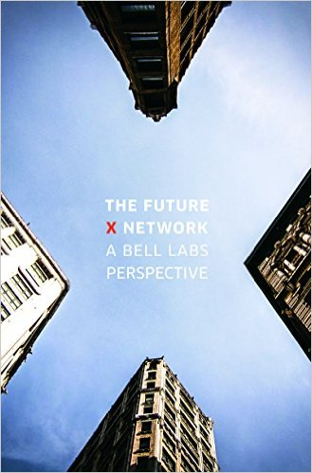
Future of communications: Nokia Bell Labs perspective
Agnieszka Szufarska
Nokia Bell Labs

Slide 2
Presentation plan:
Past and future, global trends
Connectivity in 10 years from now: what
…and how

Slide 3
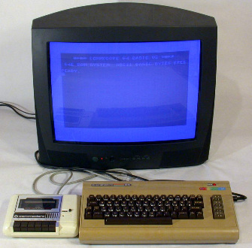
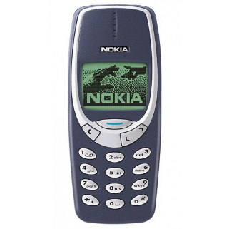

The Future X Network: The Past, Present & Future
Tech. Revolution | Enabling Technology | Connectivity
Financial (1600 − 1740) | Stocks & Bonds | Banking & Stock Market Infrastructure
1st Industrial (1780 − 1840) | Steam Engine & Iron Production | Rail and Shipping Networks
2nd Industrial (1880 − 1920) | Steel & Chemicals | Extended transportation Networks Electricity & Telecom Networks
Scientific-Technical (1940 − 1970) | Analog & digital signal processing | Digital communications networks
Information (1985 − 2015) | The Web, Cloud computing & Mobile devices | Internet & Broadband Access
Automation of Everything (2015 −) | Digital interfaces & Data analysis | Cloud Integrated Network

Slide 4
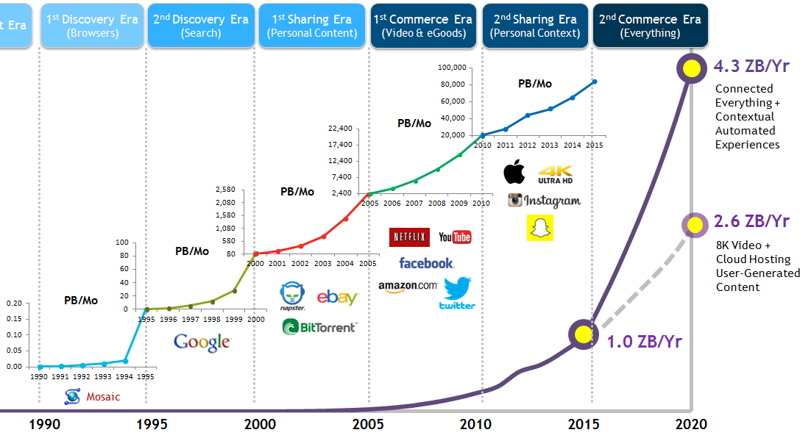

The Future X Network: A New Networking & Connectivity Era
Discover
(Information)
Share
(Media)
Sell
(Media)
Share
(Personal)
Automate
(Everything)
Enterprises
& Verticals
Consumers

Slide 5
The Future X Network: the future is very different from the past
 |  | Past | Future
Business | Solutions | Technology-driven | Human/Business need driven
 | Driver | Consumer (GB) | Industry (BW, Latency, SLA)
 | Innovation Speed | Per annum/decade (new services) | Per hour/day (new apps)
Technology | Architecture | Heavily Centralized (100ms, 10M) | Massively Distributed (1ms, 1G)
 | Flexibility | Limited (Provisioned) | Large (Software definable)
 | Sharing | Static and Limited (HW VPNs ) | Dynamic and Infinite (SW Slices)
Industry Dynamic | Investment | Singular (Operator only) | Multiple & Cooperative (Many contributors/new players)
 | Standards | Definitive | Iterative
 | Partnership | Monolithic w/Limited APIs | Modular w/Co-design & Open specs

Slide 6


Slide 7
The Future X Network: Latency Matters …
High-Frequency trading
Service latency requirements (in ms)
Light propagation in optical fiber
0.25
Edge
cloud
10
Electric grid control
1
(km)
Autonomous vehicles
2
8
10000
vRAN
4
1000
Vestibulo-ocular reflex
7
Haptic VR & tele-operation
5
20
100
Cloud-assisted driving
10
100
10
BW-efficient 360° video
10
40
Hi-Res cloud gaming
20
90
Core cloud
0.1
1
10
100
RTT
(ms)
Sprint start
120
4K video streaming
50
1900
Max tolerable networking delay
VoIP/video conferencing
100
50
ICP cloud
Max application delay for processing
Web page load
150
1000
Human response times (for reference)
IM chat & bots
150
4000

Slide 8
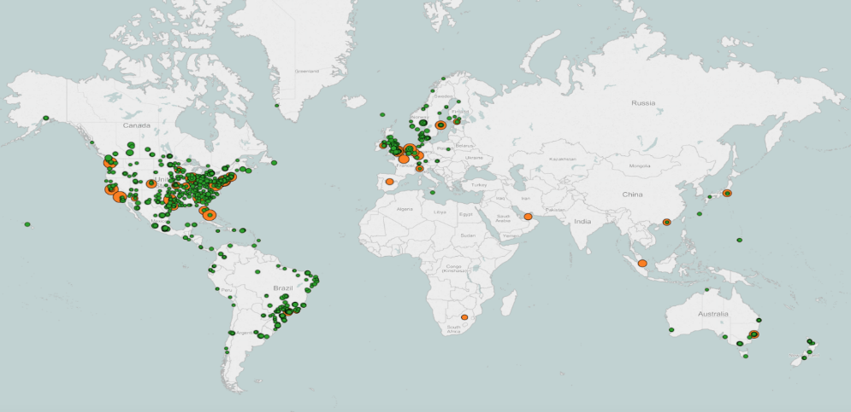
The Future X Network: Global-Local is the New Reality
Netflix Open Connect (2011-2016)
Consolidation creates local market power
  2010: Global/centralized distribution only
  2011: Open Connect launched
  2016: 100% content locally served from ~1000 locations
ISP Locations Internet Exchange Point (circles are sized by volume)
Source: Netflix, “How Netflix Works With ISPs Around the Globe to Deliver a Great Viewing Experience”, March 17, 2016

Slide 9
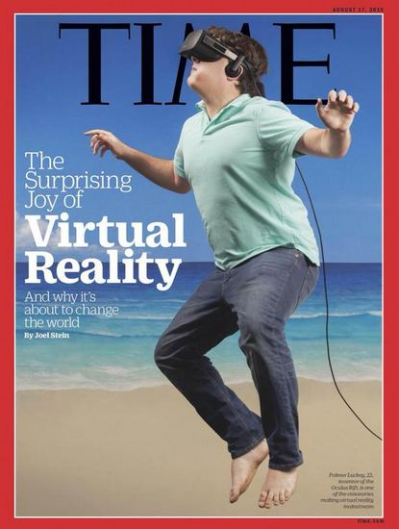
The Future X Network: 1 Gbps – Reality or Virtual ?
Immersive ‘field of view’ for Virtual Reality  ‘virtual screen’ is much larger (e.g. 20x)
  150º x 120º vs. 30º for HDTV
  With head + body motion, FoV can be 360º x 180º
Example:
Visual Acuity (1 arc min); Frame Rate 60/sec; H265 Encoding (.08 - .125 bits/pixel)
 VR Bandwidth ~0.4 – 0.7 Gbps
Motion-to-photon latency:
<15ms e2e (7-20 ms)

Slide 10
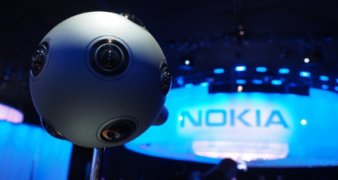
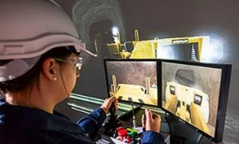
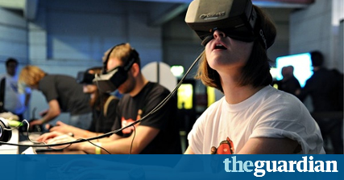
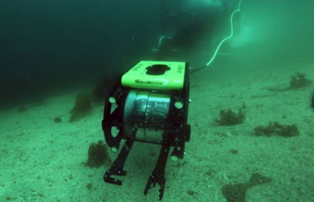
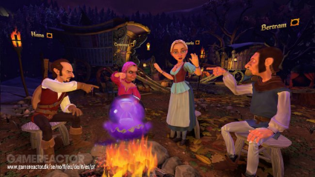
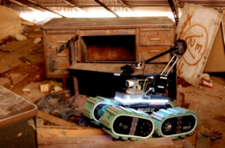

Mixed Reality
(selection of) Use Cases
Multi-user interactive environments
VR and AR gaming
Avatar-based AR/VR collaboration
Avatar-based social VR
Teleoperation
Media & Entertainment
360-degree video
Free Viewpoint VR video
Holo-video (Free Viewpoint AR)
Mining
Deep sea (oil & gas)
Search & rescue

Slide 11
The Future X Network: The 4 Key Business Value Dimensions
10Gbps
Video
360° video
(free viewpoint)
Cloud RAN
VR/AR
360° VR/AR
1Gbps
Autonomous
vehicles
360° video (hi-res)
100Mbps
Remote
training
Virtual RAN
10Mbps
Bandwidth
360° video (lo-res)
4k Video
streaming
Haptic VR
1Mbps
Things
Remote control vehicles
System
Control
HD Video
streaming
100kbps
Cloud-assisted
driving
Sensors
10kbps
Comms & Chatbots
Electric grid
control
1kbps
Home Sensors
10s
1s
100ms
10ms
1ms
100us
10us
Latency
Core Cloud
Edge Cloud

Slide 12
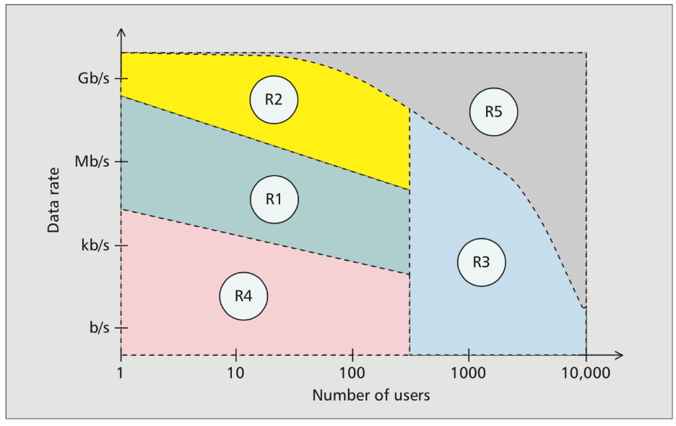
The Future X Network Simple Formula: 5G = R1 (LTE) + R2 + R3 + R4
Forbidden region: Shannon Limit
Ultra-broadband: “VR/AR”
2G-4G:
“Voice/Data/Video”
Ultra-narrowband: “Things”
Ultra-low latency: “System Control”
F. Boccardi, Bell Labs, IEEE Comms. Magazine, 201402

Slide 13
The Future X Network Simple Formula: 5G = R1 (LTE) + R2 + R3 + R4
Ultra-narrowband: “Things”
Ultra-low latency: “System Control”
F. Boccardi, Bell Labs, IEEE Comms. Magazine, 201402

Slide 14
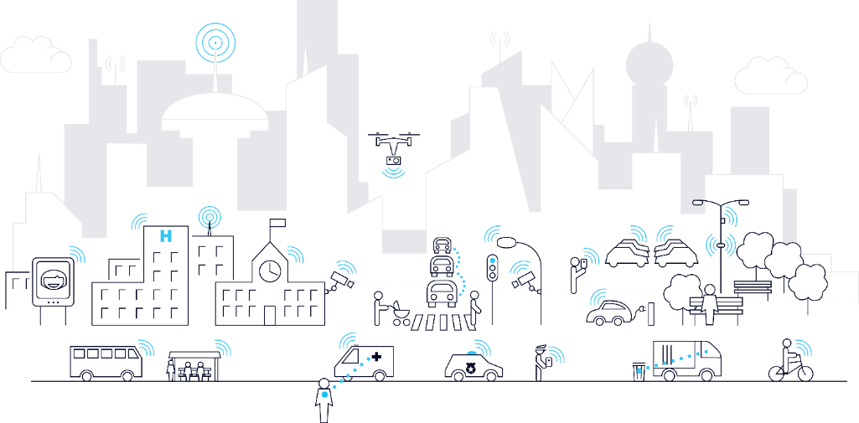
Machine connectivity: smart cities
, drones
, robots…
…wearables
, farms
, factories

Slide 15
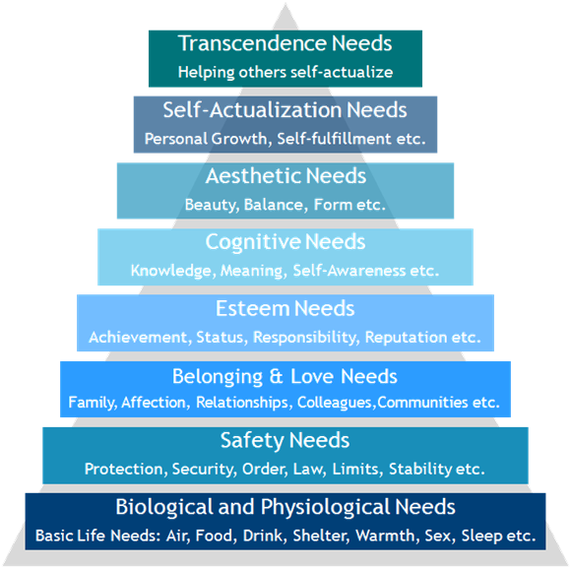
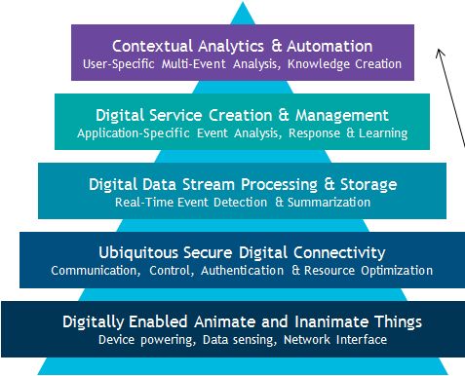
The Future X Network: The automation of everything & the creation of time
Create Time
(by Prediction
& Automation)
with Trust
(in Privacy & Security)
Analog Needs
Digital Needs

Slide 16

Connect
Accumulate
Understand
Use & steer
people & things
data
data, create knowledge
knowledge
other devices
Less time spent on things we all have to do.
More time for things we enjoy.
[Background] Source: RCRWireless

Slide 17
Sounds good.
How do we get there?

Slide 18
5G Diverse use cases
“Unlimited experience”
100 Mbps
whenever needed
>10 Gbps
peak data rates
Enhanced
Mobile
Broadband
10 000
x more traffic
“For everything”
1.000.000
devices per km²
“Instant action”
<1 ms
radio latency
mMTC
ultra low cost
Massive
machine type
communication
Ultra Reliable
Low Latency
communication
Ultra Reliable
< 10⁻⁵ outage
>10 years
on battery
Zero
mobility interruption

Slide 19

The Future X Network: 8 domains for the new digital reality
Massive Scale Access
Converged Edge Cloud
Smart Network Fabric
Universal Adaptive Core
1
Massive
MIMO
The emergence of the edge cloud for low latency and high performance
3
Access-agnostic core for seamless user experience
Scalable
Remote
2
4
Network attach
The creation of ultra-small and ultra-close access nodes
Creating dynamically reconfigurable IP + optical metro and core networks
Session mgmt.
Policy control
Programmable Network OS
Augmented Cognition Systems
Digital Value Platforms
Dynamic Data Security
5
Pervasive cognitive capabilities for operating networks & systems
7
The emergence of
new trust models & security architectures
Net OS
Net OS
Net OS
8
6
Net OS
Digital
Trust
The emergence of the network OS to enable programmability and network federation
Digital value platforms augmented by advanced network capabilities
Adaptable
Security

Slide 20
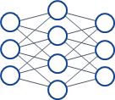


The Future X Network: The Digital Fabric of the Future
External
data sources
8
Dynamic Data Security
7
Digital Value Platforms
ecosystem
sharing
ANP, CSP, ICP, Vertical apps
new trust
framework
machine
Open APIs
6
Augmented
Cognition Systems
analytics
learning
Programmable
Network OS
dynamic
customer
services
Management &
Orchestration
dynamic
network optimization
multi-operator
federation
5
SDN
NFV
4
Universal
Adaptive Core
common
data layer
mass edge
monitoring
self-optimized
coverage
& capacity
access agnostic
converged core
modular, decomposed
network functions
short
waves
& wires
3
Smart Network Fabric
long
fibers
Humans
& Machines
2
Converged
Edge Cloud
Access
Remote
software defined, end-end
1
Massive
Scale Access

Slide 21
Explosion of possibilities: new performance levels of people and things
AUGMENTED
REDEDICATED
AUTONOMOUS
Self driving
Augmented
gaming
Work & game
while traveling
Automotive
Augmented
shopping
Time shift
Assisted driving
INTERCONNECTED
Augmented
dashboard
Maintenance optimization
Factory
automation
Logistics
Real-time
remote control
Personal
robot
Real time
work in cloud
Smart
clothes
Real world
mobility
4th industrial
revolution
3D printing
Industry 4.0
Mobile living
Smart
watch
Tracking / inventory
systems
8k Video beamer
4k Video
People & Things
REVOLUTIONIZED
Communication
VR gaming
Virtual
mobility
High performance
infrastructure
Travel &
commute
Toll collection
Traffic Mgmt.
Traffic steering &
management
Real time
cloud access
Connected
home
Virtual 3D
presence
Health
Advanced
monitoring
Smart grids
Safety & Security
Waste mgmt.
Utility & Energy
Remote
Diagnosis
Reliable emergency
communications
Touch & steer
HD Cams NW
VIRTUAL
Real-time
remote control
TACTILE
SUPEREFFICIENT
Future X, [your name], [your e-mail]
[your advanced use case proposal]

Slide 22
Thank you.

