Slide 2
The Ranges TS and Beyond
Concepts, Classes, and Algorithms, with a look to what’s beyond
Eric Niebler

Slide 3
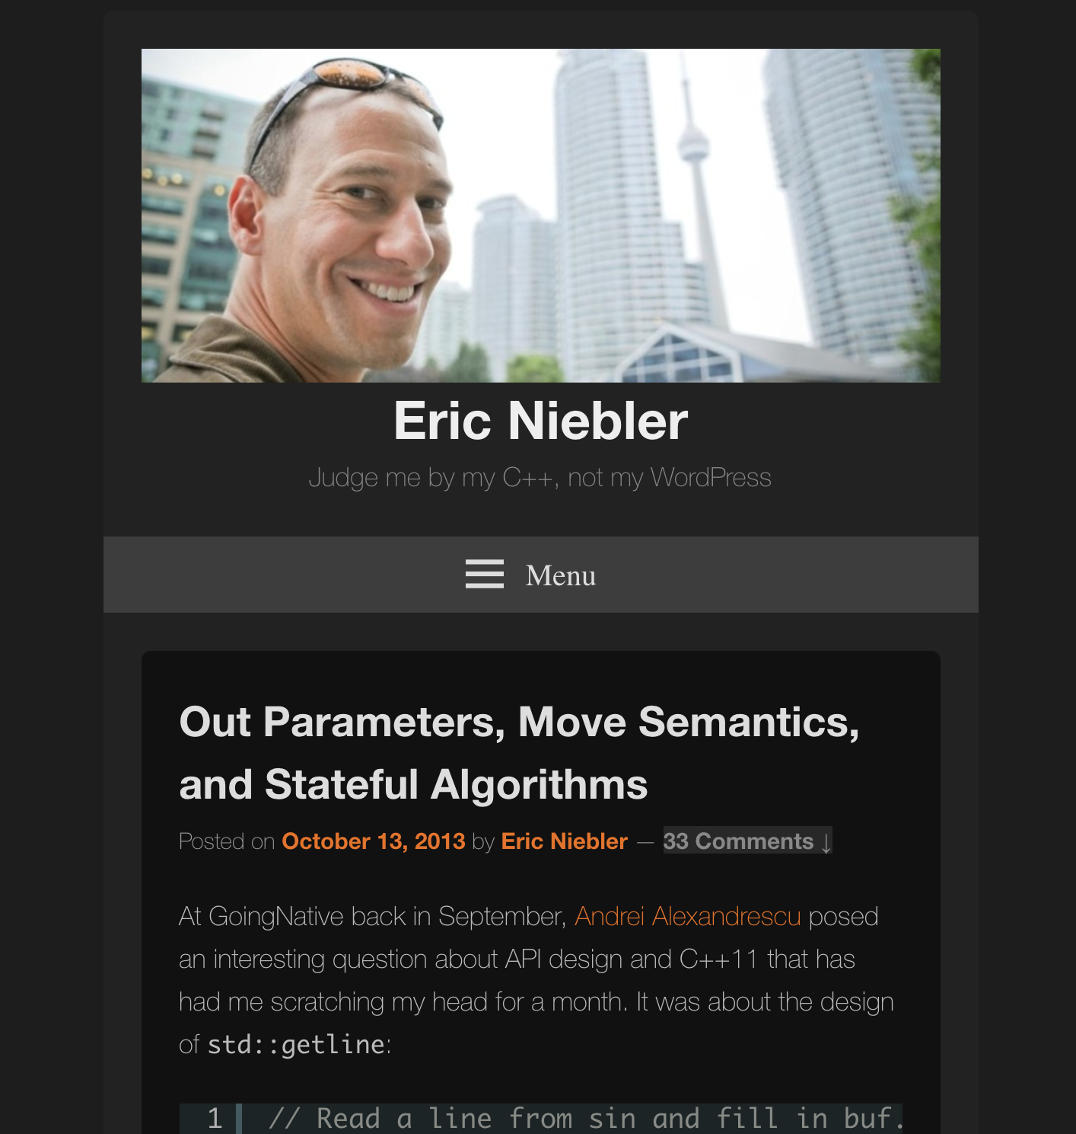
Ranges.begin()
Ranges began on Oct 13, 2013

Slide 4
Ranges.end()
Ranges TS will be officially published Nov 20, 2017

Slide 5
What’s In The Ranges TS?
Concept Definitions
Primitive (e.g., DefaultConstructible, Regular)
Iterator (e.g., InputIterator)
Callables (e.g., Invocable, Predicate)
Range (e.g., Range, View)
Iterators:
E.g., move_iterator, common_iterator, counted_iterator
Algorithms:
Iterator-based
Range-based

Slide 6
When Will My Vendor Start Shipping An Implementation?
?

Slide 7
OK, Fine. Then How Can I Get An Implementation Today?
Range-v3
https://github.com/ericniebler/range-v3
C++11 implementation for clang & gcc
Ranges TS and much more [*] not 100% to spec
CMCSTL2
http://github.com/CaseyCarter/cmcstl2
Concepts-based implementation for recent gcc releases (-fconcepts)
High fidelity to the Ranges TS working draft + proposed resolutions
Range-V3-VS2015
https://github.com/Microsoft/Range-V3-VS2015
Very out-of-date port of range-v3 to VS2015
Send complaints/bug reports to Microsoft ☺

Slide 8
Philosophy of the Ranges TS
Iterators must go!
(Sorry, Andrei)

Slide 9
Philosophy of the Ranges TS
Ranges are an abstraction over Iterators
“Position” is fundamental
Operations on Iterators form a more powerful basis
C++ is too invested in the Iterator abstraction
Extra complexity can mostly be hidden at the library level

Slide 10
Range Concept Heirarchy
Range
Container
View
SizedRange
ranges::begin(rng)
ranges::end(rng)
ranges::size(rng)
O(N) copy
O(1) copy

Slide 11
Migrating From STL Algorithms to the Ranges TS

Slide 12
Range-based algorithm overloads
Example: sorting a vector:
vector<int> vec;
std::sort(vec.begin(), vec.end());
All std algorithms have range-based overloads that dispatch to the iterator overloads
ranges::sort(vec);
::ranges (for range-v3) ::std::experimental::ranges (for Ranges TS)

Slide 13
Invocables
Example: checking all elements in a range are valid:
struct Data {
bool valid() const;
};
vector<Data> vec;
bool r = std::all_of(vec.begin(), vec.end(),
[](auto& a) { return a.valid();});
bool r = ranges::all_of(vec, &Data::valid);
Member pointers are ok as function objects

Slide 14
Projections
Example: find an element with a certain property:
struct Pair {
int first, second;
};
vector<Pair> vec;
auto it = std::find_if(vec.begin(), vec.end(),
[](auto& a) { return a.first == 42; });
auto it = ranges::find(vec, 42, &Pair::first);
Projections transform the input sequence
Invocables are ok here, too

Slide 15
Sentinels
decltype(rng.begin()) decltype(rng.end())

Slide 16
Sentinel Example: C-style strings
// A sentinel representing the end of a null-terminated string:
struct null_terminator {};
bool operator==(char const* s, null_terminator) { return *s == '\0'; }
bool operator==(null_terminator n, char const* s) { return s == n; }
bool operator!=(char const* s, null_terminator n) { return !(s == n); }
bool operator!=(null_terminator n, char const* s) { return !(s == n); }
...
template <InputIterator I, Sentinel<I> S, class T>
requires EqualityComparable<reference_t<I>, const T&>
I find( I first, S last, const T& value ) {
for ( ; first != last; ++first )
if ( *first == value )
break;
return first;
}
Very efficient!

Slide 17
Sentinel: Caveat!
A gross misappropriation of syntax
”==” here does not mean they represent the same value
Sorry, John! ☹
John “Value Semantics!” Lakos
Image from isocpp.org, used without permission

Slide 18
Sentinels
By allowing the type of the end iterator to differ from the begin we:
Give the optimizer more context, resulting in better codegen
Make it easier to write correct iterators

Slide 19
Beyond the Ranges TS: Range Views

Slide 20
Views: Pipelines of lazy computation
int main() {
using namespace std::experimental::ranges;
// {0,1,2,3,4,5,6,7,8,9}
std::vector<int> is = view::iota(0, 10);
auto is_even = [](int i) { return i % 2 == 0; };
for (int i : is | view::filter(is_even))
std::cout << i << ' '; // 0 2 4 6 8
}
view::iota: generate half-open range of incrementable things.
view::filter: filter out elements that fail to satisfy a predicate.

Slide 21
P0789: Range Adaptors and Utilities
Introduced at last week’s C++ Committee Meeting
Warmly received in LEWG, forwarded to LWG

Slide 22
P0789: Range Adaptors and Utilities
Utilities (view_interface, subrange)
View adaptors:
all, iota, filter, transform, single, empty, reverse, take, join, split, counted, bounded
More to come...

Slide 23
Beyond the Ranges TS: Parallel Ranges

Slide 24
Parallelism TS & C++17
Execution policies:
sequential
parallel
parallel & vector
Algorithm overloads that take execution policies

Slide 25
Parallel Algorithm Example
int main() {
std::vector<int> is = makeBigVector();
std::sort(std::par, v.begin(), v.end());
}
In parallel, please!

Slide 26
Parallel Algorithms: The Bad News
No standard GPU execution policy
Even if there were, the interface forces a data round-trip to the GPU for each algorithm invocation.
Parallel Algorithms Don’t Compose

Slide 27
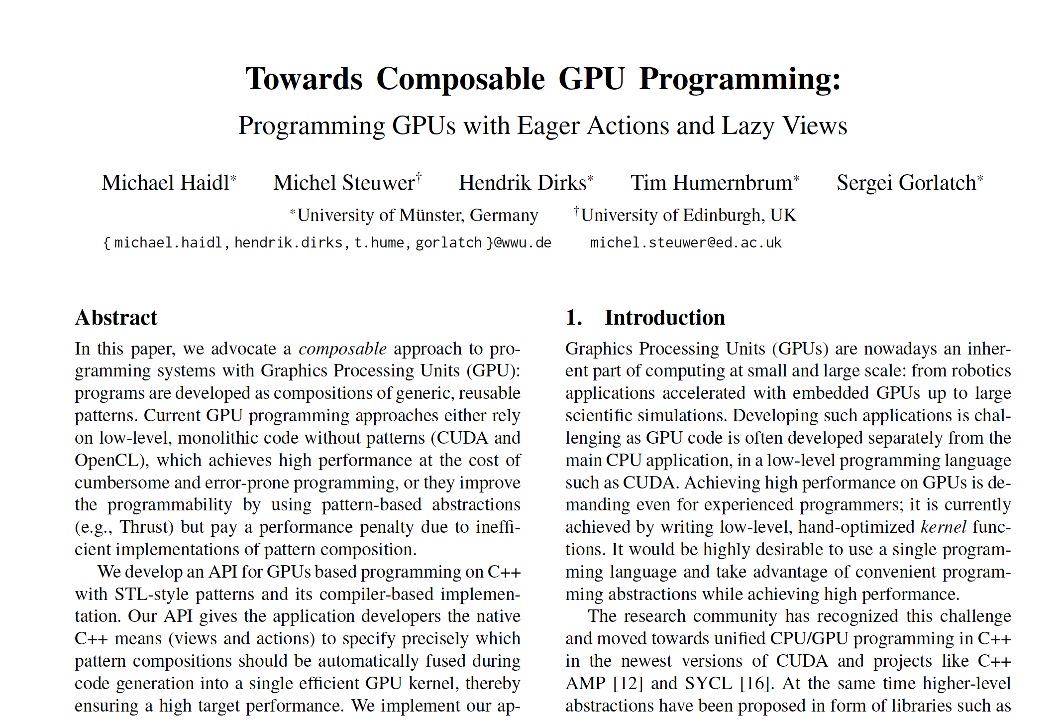
GPU + Ranges == ❤️
“In our approach, programmers obtain full control to either
use patterns expressed as STL algorithms and actions which are computed eagerly on the GPU or
use views which our implementation guarantees to fuse during code generation and execute in a single GPU kernel.”

Slide 28
Composable GPU computation
float dotProduct(const vector<float>& a,
const vector<float>& b) {
auto mult = [](auto p){
return get<0>(p) * get<1>(p); };
return view::zip(gpu::copy(a), gpu::copy(b))
| view::transform(mult)
| gpu::reduce(0.0f);
}

Slide 29
GPU+Ranges vs. Hand-optimized CUDA
Ranges
Ranges
CUDA
Haidl, Steuwer, Dirks, Humernbrum, Gorlatch; 2016
Notes:
- CUDA version from NVIDIA’s SDK. Uses a tree-based reduction in local memory and avoids synchronization inside a warp.
- The Thrust reduction algorithm computes the result in two GPU kernels.
- PACXX and the CUDA versions execute only one GPU kernel and finish the computation on the CPU.

Slide 30
CodePlay & SYCL
Custom executors for targeting GPU
Experimental integration of ranges with SYCL (OpenCL abstraction layer in standard C++)
Toy examples here: https://github.com/codeplaysoftware/parallelts-range-exploration
Michael Wong
Notes:
C++ Single-source Heterogeneous Programming for OpenCL
SYCL (pronounced ‘sickle’) is a royalty-free, cross-platform abstraction layer that builds on the underlying concepts, portability and efficiency of OpenCL that enables code for heterogeneous processors to be written in a “single-source” style using completely standard C++. SYCL enables single source development where C++ template functions can contain both host and device code to construct complex algorithms that use OpenCL acceleration, and then re-use them throughout their source code on different types of data.

Slide 31
Programming for the GPU can be declarative, portable, composable, and as efficient as hand-optimized, low-level, GPU-specific algorithms.

Slide 32
Beyond the Ranges TS: Ranges and Coroutines

Slide 33
Ranges and Coroutines
Coroutine: light-weight, cooperative multi-tasking
Coroutines TS: sent for publication
co_await, co_yield, co_return
A plausible addition for C++20

Slide 34
Building a Range with Coroutines and Range-v3
// A lazy range of all the integers[*]:
generator<int> infinite_sequence() {
for (int i = 0; ; ++i) {
co_yield i; // “Suspend” the coroutine!
}
}
// A lazy range of all the integers[*]:
generator<int> infinite_sequence() {
for (int i = 0; ; ++i) {
co_yield i; // “Suspend” the coroutine!
}
}
// Print the first 10 integers
ranges::for_each(
infinite_sequence() | view::take(10), // view::take from range-v3
[](int x) { std::cout << x; });
[*] Using generator from https://github.com/toby-allsopp/ranges-coroutines

Slide 35
Filtering a Range with Coroutines
// Filter out from a range all the elements that don’t satisfy
// a predicate:
template <class Rng, class Pred, class I = iterator_t<Rng>>
requires InputRange<Rng> && IndirectPredicate<Pred, I>
generator<value_type_t<I>> filter_co( Rng && range, Pred pred )
{
for (auto&& x : range)
if (pred(x))
co_yield x;
}
// Filter out from a range all the elements that don’t satisfy
// a predicate:
template <class Rng, class Pred, class I = iterator_t<Rng>>
requires InputRange<Rng> && IndirectPredicate<Pred, I>
generator<value_type_t<I>> filter_co( Rng && range, Pred pred )
{
for (auto&& x : range)
if (pred(x))
co_yield x;
}
auto evens = filter_co(infinite_sequence(),
[](int x) { return x % 2 == 0; });

Slide 36
Filtering a Range with Coroutines
template <class UnaryPredicate>
auto filter_co( UnaryPredicate pred )
{
return ranges::make_pipeable( // From range-v3
[=](InputRange && rng) {
using Rng = decltype(rng);
return filter_co(std::forward<Rng>(rng), pred);
});
}
template <class UnaryPredicate>
auto filter_co( UnaryPredicate pred )
{
return ranges::make_pipeable( // From range-v3
[=](InputRange && rng) {
using Rng = decltype(rng);
return filter_co(std::forward<Rng>(rng), pred);
});
}
auto x = infinite_sequence()
| filter_co([](int x) { return x % 2 == 0; })
| view::take(10); // From range-v3

Slide 37
Asynchronous Ranges
Hand-Wavy Future Directions for Ranges and Coroutines

Slide 38
Asynchronous Ranges
Coroutines TS defines an asynchronous range-based for loop.
for co_await ( auto&& x : rng ) {
do_something_with( x );
}
{
auto __begin = co_await ranges::begin(__range),
auto __end = ranges::end(rng);
for (; __begin != __end; co_await ++__begin ) {
auto&& x = *__begin;
do_something_with( x );
}
}
Asynchronously fetch the first element
Asynchronously fetch the next element

Slide 39
Asynchronous Range Concept
template <class I>
using await_resume_t = decltype(std::declval<I&>().await_resume());
template <class I>
using await_resume_t = decltype(std::declval<I&>().await_resume());
template <class I>
concept bool AsyncInputIterator =
Readable<I> && // *i “reads” a value
Semiregular<I> && // Copyable and movable with “regular” semantics
requires(I i) {
typename difference_type_t<I>;
{ (++i).await_resume() } -> Same<I&>;
i++;
};
template <class I>
using await_resume_t = decltype(std::declval<I&>().await_resume());
template <class I>
concept bool AsyncInputIterator =
Readable<I> && // *i “reads” a value
Semiregular<I> && // Copyable and movable with “regular” semantics
requires(I i) {
typename difference_type_t<I>;
{ (++i).await_resume() } -> Same<I&>;
i++;
};
template <class R>
concept bool AsyncInputRange =
AsyncInputIterator<await_resume_t<iterator_t<R>> &&
WeaklyEqualityComparable<await_resume_t<iterator_t<R>>, sentinel_t<R>>;

Slide 40
Asynchronous Algorithms
// Now define a set of algorithm overloads over asynchronous ranges, like…
template <AsyncInputIterator I, Sentinel<I> S, class T>
requires EqualityComparable<reference_t<I>, T&>
task<I> find( I first, S last, T value )
{
for (; i != last; co_await ++i)
if (*i == value)
break;
co_return i;
}
// Now define a set of algorithm overloads over asynchronous ranges, like…
template <AsyncInputIterator I, AsyncSentinel<I> S, class T>
requires EqualityComparable<reference_t<I>, T&>
task<I> find( I first, S last, T value )
{
for (; i != last; co_await ++i)
if (*i == value)
break;
co_return i;
}
template <AsyncView Rng, class T>
requires EqualityComparable<reference_t<await_resume_t<iterator_t<Rng>>>, T&>
task<safe_iterator_t<R>> find( Rng rng, T value )
{
co_return find( co_await begin(rng), end(rng), value );
}

Slide 41
… and Then
Define a set of asynchronous views over asynchronous ranges
Filter and transform an infinite, asynchronous sequence of…
Network packets
User interface events (mouse movements, keyboard input)
File system notifications
Whatever!

Slide 42
Publisher and Subscriber
Subscribe, process, and unsubscribe to a stream.
// Subscribe to an observable, read n elements, disconnect. template <Observable O> // C++20 concepts task<void> consume_n(O observable, int n) { // C++17 structured binding. Subscribe returns a std::pair. auto [producer, range] = observable.subscribe(); // Asynchronously loop over the elements of the stream for co_await( auto element : range | view::filter(pred) ) { do_work(element); // process the element if (n-- == 0) break; } co_await producer.unsubscribe(); // disconnect from the source }

Slide 43
Hello, reactive programming

Slide 44
Coroutines and Ranges
Coroutines make it trivial to define lazily-evaluated views of data sequences.
The Ranges TS provides algorithms that make operating on views easy.

Slide 45
Coroutines and Ranges
Ranges can also be asynchronous.
With algorithms and views that are async-aware, we can write generic code that is either imperative or reactive depending on input.

Slide 46
Questions?

Slide 47
Bonus Slides!
Sentinels

Slide 48
Mission:Possible
Write an iterator over a C-style null-terminated string

Slide 49
Mission:Possible -- STL
class c_str_iter : public std::iterator<
std::forward_iterator_tag, char, std::ptrdiff_t, char const*, char const&> {
char const* p = nullptr;
public:
c_str_iter() = default;
explicit c_str_iter(char const* q) : p(q) {}
bool operator==(c_str_iter that) {
return p ? (that.p == p || (!that.p && !*p)) : (!that.p || !*that.p); }
bool operator!=(c_str_iter that) { return !(*this == that); }
char const& operator*() const { return *p; }
char const* operator->() const { return p; }
c_str_iter& operator++() { ++p; return *this; }
c_str_iter operator++(int) { return std::exchange(*this, std::next(*this)); }
};
p == nullptr means “end of string”

Slide 50
Mission:Possible, Benchmark!
int c_strlen( char const *sz ) {
int i = 0;
for(; *sz; ++sz)
++i;
return i;
}
int range_strlen( c_str_iter begin, c_str_iter end ) {
int i = 0;
for(; begin != end; ++begin)
++i;
return i;
}
C-style, badness
STL-style, goodness (?)

Slide 51
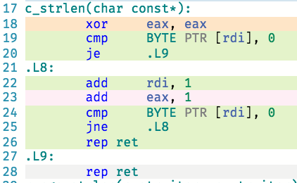
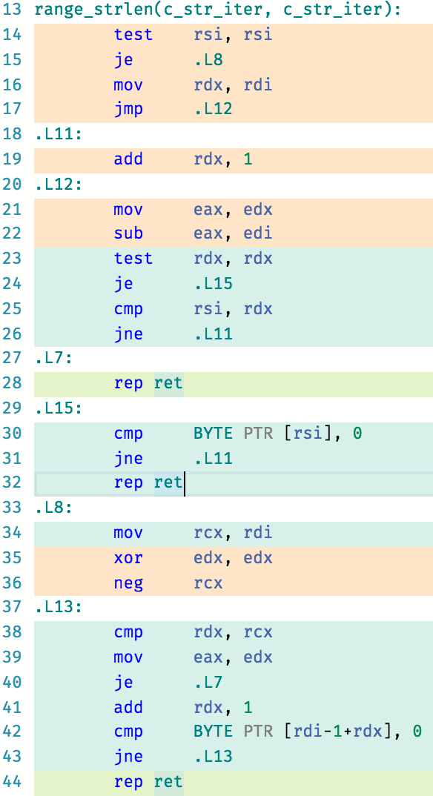
Mission:Possible, but Awful
c_strlen
range_strlen
☹
gcc-snapshot, -O3
godbolt.org

Slide 52
Mission:Possible – Ranges TS
class c_str_iter2 : public std::iterator<
ranges::forward_iterator_tag, char, std::ptrdiff_t, char const*, char const&> {
char const* p = nullptr;
public:
c_str_iter2() = default;
explicit c_str_iter2(char const* q) : p(q) {}
bool operator==(c_str_iter2 that) { return p == that.p; }
bool operator!=(c_str_iter2 that) { return p != that.p; }
char const& operator*() const { return *p; }
char const* operator->() const { return p; }
c_str_iter2& operator++() { ++p; return *this; }
c_str_iter2 operator++(int) { return std::exchange(*this, std::next(*this)); }
};
bool operator==(c_str_iter2 a, ranges::default_sentinel) { return !*a; }
bool operator==(ranges::default_sentinel, c_str_iter2 a) { return !*a; }
bool operator!=(c_str_iter2 a, ranges::default_sentinel) { return *a; }
bool operator!=(ranges::default_sentinel, c_str_iter2 a) { return *a; }

Slide 53
Mission:Possible, String Algorithms
int c_strlen( char const *sz ) {
int i = 0;
for(; *sz; ++sz)
++i;
return i;
}
int range_strlen2( c_str_iter2 begin, ranges::default_sentinel end ) {
int i = 0;
for(; begin != end; ++begin)
++i;
return i;
}
C-style, badness
Ranges TS-style, goodness (!)

Slide 54
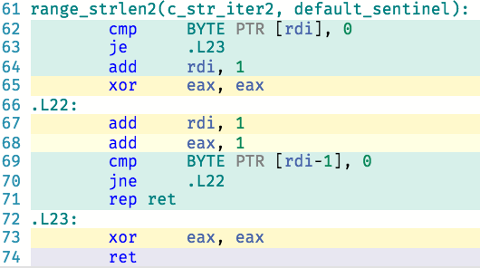
Mission:Possible, and Awesome!
c_strlen
range_strlen2
☺
gcc-snapshot, -O3
godbolt.org

Slide 55
Moar Bonus Slides!
Projections

Slide 56
Why Projections?
Increase interface symmetry of the STL algorithms
std::sort(a.begin(), a.end(), [](const employee& x, const employee& y) {
return x.last < y.last; });
auto p = std::lower_bound(a.begin(), a.end(), "Parent",
[](const employee& x, const string& y) {
return x.last < y; });
ranges::sort(a, ranges::less<>(), &employee::last);
auto p = ranges::lower_bound(a, "Parent", ranges::less<>(), &employee::last);
(Example stolen shamelessly from Sean Parent)

Slide 57
Why Projections? Part 2
Increase mathematical soundness of the STL algorithms
std::equal(employees.begin(), employees.end(), ids.begin(),
[](employee& e, int i) { return e.id == i; });
OK!
ranges::equal(employees, ids,
[](employee& e, int i) { return e.id == i; });
ERROR!

Slide 58
Cross-type Relations
A function of two arguments that returns a Boolean and establishes a mathematical relationship between them. | E.g. less-than, equal-to
Must be symmetric: | r(a, b) and r(b, a)
Must exhibit a common type: | r(a, b) ≅ r(true ? a : b, true ? b : a)

Slide 59
Cross-type Relations
“These are strong requirements, but we feel that they are justified. The additional requirements make it possible to reason about the semantics of cross-type relations; they make it possible to describe such relations as equivalence relations or strict weak orderings.”
-- N3351, the “Palo Alto Report”

Slide 60
Why Projections? Part 2
Increase mathematical soundness of the STL algorithms
std::equal(employees.begin(), employees.end(), ids.begin(),
[](employee& e, int i) { return e.id == i; });
OK!
ranges::equal(employees, ids,
[](employee& e, int i) { return e.id == i; });
ERROR!
ranges::equal(employees, ids, std::equal_to<>(), &Employee::id);
OK!

Slide 61
Still Moar Bonus Slides!
Defining Your Own Algorithms with the Ranges TS

Slide 62
Range TS-ify an algorithm
template <typename I>
void insertion_sort(I first, I last)
{
for (I i = first; i != last; ++i)
std::rotate(std::upper_bound(first, i, *i), i, std::next(i));
}

Slide 63
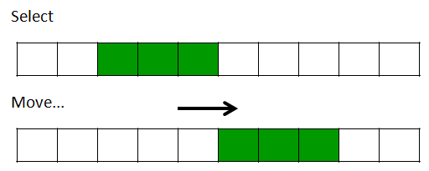
Range TS-ify an algorithm
template <typename I>
void insertion_sort(I first, I last)
{
for (I i = first; i != last; ++i)
std::rotate(std::upper_bound(first, i, *i), i, std::next(i));
}
template <typename I>
void insertion_sort(I first, I last)
{
for (I i = first; i != last; ++i)
ranges::rotate(ranges::upper_bound(first, i, *i), i, ranges::next(i));
}
Prefer the components in the Ranges TS because they are properly constrained with Concepts

Slide 64
Range TS-ify an algorithm
template <typename I>
void insertion_sort(I first, I last)
{
for (I i = first; i != last; ++i)
ranges::rotate(ranges::upper_bound(first, i, *i), i, ranges::next(i));
}
template <ranges::ForwardIterator I>
void insertion_sort(I first, I last)
{
for (I i = first; i != last; ++i)
ranges::rotate(ranges::upper_bound(first, i, *i), i, ranges::next(i));
}
Constrain your algorithms with concepts from the Ranges TS

Slide 65
Range TS-ify an algorithm
template <ranges::ForwardIterator I>
void insertion_sort(I first, I last)
{
for (I i = first; i != last; ++i)
ranges::rotate(ranges::upper_bound(first, i, *i), i, ranges::next(i));
}
template <ranges::ForwardIterator I, ranges::Sentinel<I> S>
void insertion_sort(I first, S last)
{
for (I i = first; i != last; ++i)
ranges::rotate(ranges::upper_bound(first, i, *i), i, ranges::next(i));
}
Use iterator/sentinel pairs to denote ranges.

Slide 66
Range TS-ify an algorithm
template <ranges::ForwardIterator I, ranges::Sentinel<I> S>
void insertion_sort(I first, S last)
{
for (I i = first; i != last; ++i)
ranges::rotate(ranges::upper_bound(first, i, *i), i, ranges::next(i));
}
template <ranges::ForwardIterator I, ranges::Sentinel<I> S>
I insertion_sort(I first, S last)
{
I i = first;
for (; i != last; ++i)
ranges::rotate(ranges::upper_bound(first, i, *i), i, ranges::next(i));
return i;
}
If your algorithm computes the end iterator position, return it.

Slide 67
Range TS-ify an algorithm
template <ranges::ForwardIterator I, ranges::Sentinel<I> S>
I insertion_sort(I first, S last)
{
I i = first;
for (; i != last; ++i)
ranges::rotate(ranges::upper_bound(first, i, *i), i, ranges::next(i));
return i;
}
template <ranges::ForwardIterator I, ranges::Sentinel<I> S>
I insertion_sort(I first, S last)
{
I i = first;
for (; i != last; ++i)
ranges::rotate(ranges::upper_bound(first, i, *i), i, ranges::next(i));
return i;
}
template <ranges::ForwardRange R>
ranges::safe_iterator_t<R> insertion_sort(R&& r)
{
return insertion_sort(ranges::begin(r), ranges::end(r));
}
Add an overload that takes a range (and constrain it!)

