Slide 1
Python
What NOT To Do

Slide 2
The stereotype

Slide 3
Side effect
It’s way too easy to write code that works.

Slide 4
Example: for loop
basket = ['Apples', 'Oranges', 'Bananas']
for i in range(len(basket)):
print(basket[i])
basket = ['Apples', 'Oranges', 'Bananas']
for item in basket:
print(item)

Slide 5
Example: for loop with index
basket = ['Apples', 'Oranges', 'Bananas']
for i in range(len(basket)):
print('{}. {}'.format(i, basket[i]))
basket = ['Apples', 'Oranges', 'Bananas']
for i, item in enumerate(basket):
print('{}. {}'.format(i, item))

Slide 6
Learning Python the easy way
Understand Python is easy
Write a lot of code fast
Blame Python for being unreadable
Success!

Slide 7
The solution
Learn how to do things in a “pythonic” way.
Learn what NOT to do.

Slide 8
Tip #1
Google even the simplest things using this phrase:

Slide 9
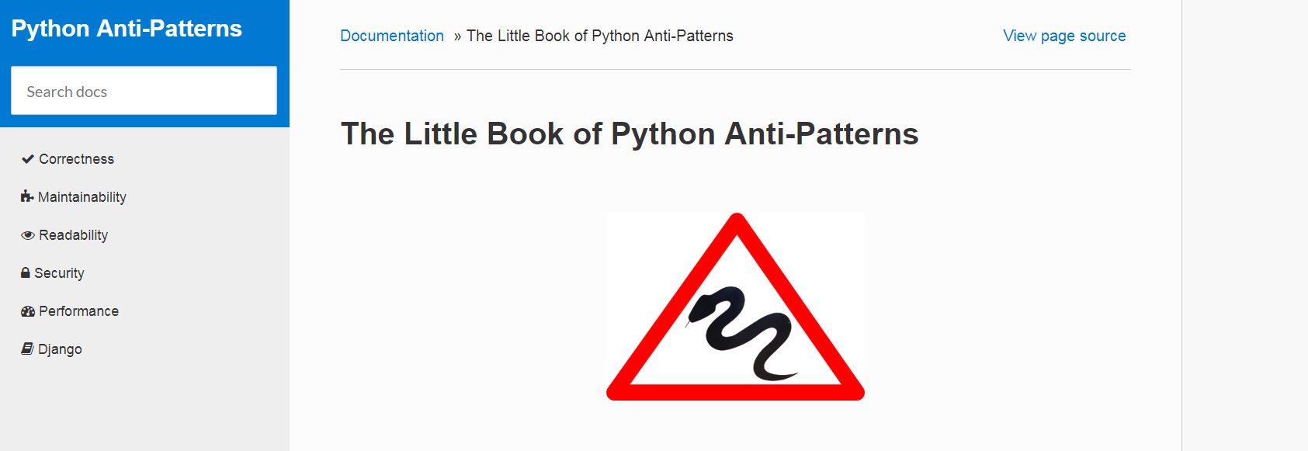
Tip #2
Read “The Little Book of Python Anti-Patterns”

Slide 10
Tip #3
Stay for the rest of this talk ☺️

Slide 11
Agenda
Suppressing exceptions
Less obvious ways of ruining your life than
except Exception
Enabling warnings globally
How to mess up everyone's logs in an obscure fashion.

Slide 12
Exceptions

Slide 13
The ultimate sin
try:
do_something()
except:
do_something_else()

Slide 14
This is almost just as bad
try:
do_something()
except Exception:
do_something_else()

Slide 15
This forces others to sin
raise Exception('Bad stuff happened!')

Slide 16
But there’s more...

Slide 17
class FridgeError(Exception):
pass
class Fridge(object):
def open(self):
raise FridgeError('Broken Fridge')
def close(self):
pass
def __iter__(self):
pass
def collect_fruits(fridge):
fruits = []
try:
fridge.open()
for shelf in fridge:
fruits += shelf.fruits
finally:
fridge.close()
return fruits
collect_fruits(Fridge())

Slide 18
class FridgeError(Exception):
pass
class Fridge(object):
def open(self):
raise FridgeError('Broken Fridge')
def close(self):
pass
def __iter__(self):
pass
def collect_fruits(fridge):
fruits = []
try:
fridge.open()
for shelf in fridge:
fruits += shelf.fruits
finally:
fridge.close()
return fruits
collect_fruits(Fridge())

Slide 19
Traceback (most recent call last):
File "main.py", line 61, in <module>
collect_fruits(Fridge())
File "main.py", line 53, in collect_fruits
fridge.open()
File "main.py", line 41, in open
raise FridgeError('Broken Fridge')
__main__.FridgeError: Broken Fridge

Slide 20
Why does this happen?
A function can either return a value or raise an exception, it cannot do both.

Slide 21
How to avoid it and live a happy life?
Do not return anything in finally: block.

Slide 22
Warnings

Slide 23
Food package
additives.py
fruits.py
import warnings
class ArsenicWarning(UserWarning):
pass
class Arsenic(object):
def __init__(self):
warnings.warn('This product is poisonous!',
ArsenicWarning)
from additives import Arsenic
class Orange(object):
def __init__(self):
self.content = Arsenic()

Slide 24
from food.fruits import Orange
my_orange = Orange()
> python main.py
/food/additives.py:11: ArsenicWarning: This product is poisonous!
warnings.warn('This product is poisonous!', ArsenicWarning)

Slide 25
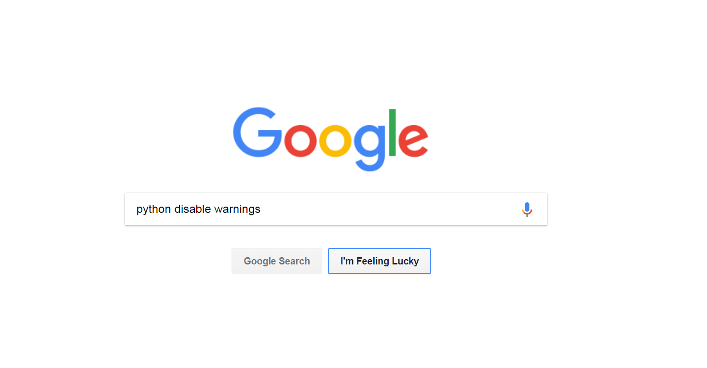

Slide 27
Food package
additives.py
fruits.py
import warnings
class ArsenicWarning(UserWarning):
pass
class Arsenic(object):
def __init__(self):
warnings.warn('This product is poisonous!',
ArsenicWarning)
import warnings
from additives import Arsenic
warnings.filterwarnings('ignore')
class Orange(object):
def __init__(self):
self.content = Arsenic()

Slide 28
from food.fruits import Orange
my_orange = Orange()
> python main.py
Process finished with exit code 0

Slide 29
Food package
vegetables.py
class OldTomato(object):
def __init__(self):
pass

Slide 30
Food package
vegetables.py
import warnings
class Tomato(object):
def __init__(self):
pass
def OldTomato():
warnings.warn('Deprecated! Use Tomato instead!',
DeprecationWarning)

Slide 31
from food.vegetables import OldTomato
my_tomato = OldTomato()
> python main.py
Process finished with exit code 0

Slide 32
Food package
vegetables.py
import warnings
warnings.filterwarnings("always")
class Tomato(object):
def __init__(self):
pass
def OldTomato():
warnings.warn('Deprecated! Use Tomato instead!',
DeprecationWarning)

Slide 33
from food.vegetables import OldTomato
my_tomato = OldTomato()
> python main.py
/food/vegetables.py:13: DeprecationWarning: Deprecated! Use Tomato instead!
warnings.warn('Deprecated! Use Tomato instead!', DeprecationWarning)

Slide 34
from food.vegetables import OldTomato
from food.fruits import Orange
my_tomato = OldTomato()
my_orange = Orange()
> python main.py
Process finished with exit code 0

Slide 35
from food.fruits import Orange
from food.vegetables import OldTomato
my_tomato = OldTomato()
my_orange = Orange()
> python main.py
/food/vegetables.py:13: DeprecationWarning: Deprecated! Use Tomato instead!
warnings.warn('Deprecated! Use Tomato instead!', DeprecationWarning)
/food/additives.py:11: ArsenicWarning: This product is poisonous!
warnings.warn('This product is poisonous!', ArsenicWarning)

Slide 36
Why does this happen?
warnings.filterwarnings manages warnings globally, so it’s possible to affect warnings outside current module.

Slide 37
How to avoid it and live a happy life?
If possible - do not do it on library level and let the user control warnings in his own code.

Slide 38
How to avoid it and live a happy life?
If you absolutely need to - at least be precise.

Slide 39
Food package
additives.py
fruits.py
import warnings
class ArsenicWarning(UserWarning):
pass
class Arsenic(object):
def __init__(self):
warnings.warn('This product is poisonous!',
ArsenicWarning)
import warnings
from additives import Arsenic, ArsenicWarning
warnings.filterwarnings('ignore',
category=ArsenicWarning,
module='food.additives')
class Orange(object):
def __init__(self):
self.content = Arsenic()

Slide 40
Food package
vegetables.py
import warnings
warnings.filterwarnings('always',
category=DeprecationWarning,
module=__name__)
class Tomato(object):
def __init__(self):
pass
def OldTomato():
warnings.warn('Deprecated! Use Tomato instead!',
DeprecationWarning)

Slide 41
from food.fruits import Orange
from food.vegetables import OldTomato
my_tomato = OldTomato()
my_orange = Orange()
> python main.py
/food/vegetables.py:13: DeprecationWarning: Deprecated! Use Tomato instead!
warnings.warn('Deprecated! Use Tomato instead!', DeprecationWarning)

Slide 42
Tip #4
Same logic applies to logging and methods like basicConfig or setLevel.

Slide 43
More fun
github.com/alexpilk/python-sandbox/

