Slide 1
BLACK-BOX PERFORMANCE ANALYSIS
Dmitry Trukhanov

Slide 2
What
Your program
User input
OS Impact

Slide 3
Why?

Slide 4
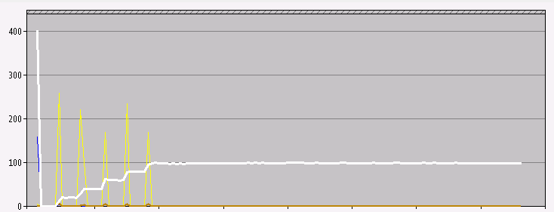

Slide 5
How?

Slide 6
Metrics!
Perfmon for Windows
Zabbix, Nagios for Windows and Linux

Slide 7
Standards!
Baseline
Test plan
Time intervals
Cooldown
Tools
Environmetn

Slide 8
Questions?

